Slide 1
Chapter 18: Electrical Properties
ISSUES TO ADDRESS...
• How are electrical conductance and resistance
characterized?
• What are the physical phenomena that distinguish
conductors, semiconductors, and insulators?
• For metals, how is conductivity affected by
imperfections, T, and deformation?
• For semiconductors, how is conductivity affected
by impurities (doping) and T?

Slide 2
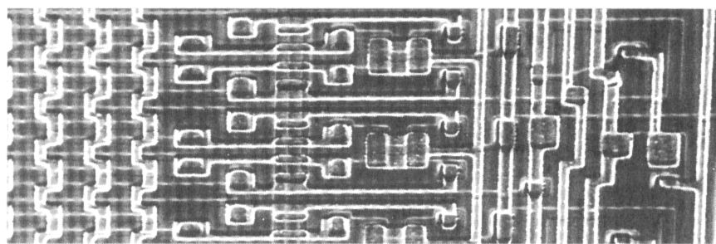
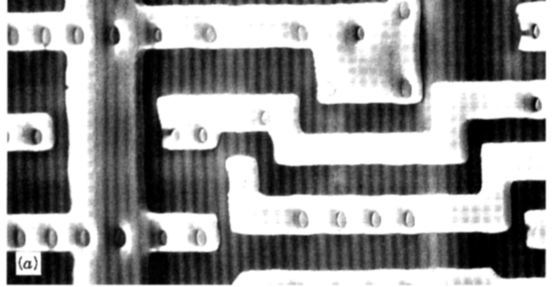


View of an Integrated Circuit
• Scanning electron microscope images of an IC:
Al
(d)
(d)
(a)
Si
(doped)
45 μm
0.5 mm
• EDS map showing location of Si (a semiconductor):
-- Si shows up as light regions.
(b)
• EDS map showing location of Al (a conductor):
-- Al shows up as light regions.
(c)

Slide 3
Electrical Conduction
• Ohm's Law:
V = I R
voltage drop (volts = J/C)
C = Coulomb
resistance (Ohms)
current (amps = C/s)
• Resistivity, ρ: -- a material property that is independent of sample size and geometry
cross-sectional area
of current flow
current flow path length
• Conductivity, σ

Slide 4
Electrical Conduction
• Ohm's Law:
ΔV = I R
voltage drop (volts)
C = Coulomb
resistance (Ohms)
current (amps = C/s)
A
(cross
e
-
I
sect.
ΔV
area)
L
• Resistance:
Resitivity: ρ (Ohm-m)
Conductivity: 1/ρ (Ohm-m)⁻¹

Slide 5
Electrical Properties
Which will have the greater resistance?
Analogous to flow of water in a pipe
Resistance depends on sample geometry and size.
2
D
2D

Slide 6
Definitions
Further definitions
J = σ ε <= another way to state Ohm’s law
J ≡ current density = current / area = I/A
ε ≡ electric field = V/L or (ΔV/Δ L )
J = σ (ΔV/ΔL)
Electron flux conductivity voltage gradient
Current carriers
electrons in most solids
ions can also carry (particularly in liquid solutions)

Slide 7
Conductivity: Comparison
-1
-1
• Room T values (Ohm-m)
= (Ω - m)
= S/m
METALS
conductors
CERAMICS
Silver
6.8 x 10
7
Soda-lime glass 10
-10
-10
-11
Copper
6.0 x 10
7
Concrete 10
-9
Iron
1.0 x 10
7
Aluminum oxide <10
-13
SEMICONDUCTORS
POLYMERS
Silicon
4 x 10
-4
Polystyrene <10
-14
Germanium
2 x 10
0
Polyethylene 10
-15
-10
-17
GaAs
10
-6
4
PEDOT
10
insulators
semiconductors

Slide 8
Example: Conductivity Problem
What is the minimum diameter (D) of the wire so that ΔV < 1.5 V?
100m
-
e
-
I = 2.5A
+
Cu wire
ΔV
100m
< 1.5V
2.5A
7
-1
6.07 x 10 (Ohm-m)
Solve to get D > 1.87 mm

Slide 9
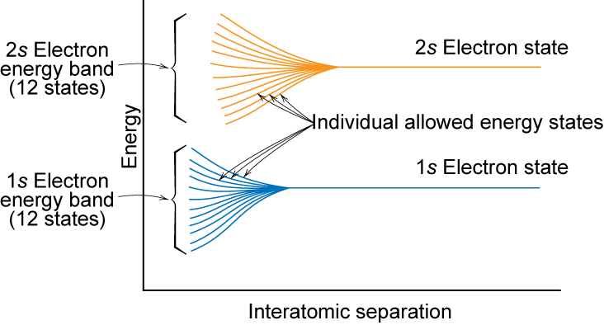
Electronic Band Structures
Notes:
So the individual atomic energy levels interact to form molecular energy levels

Slide 10
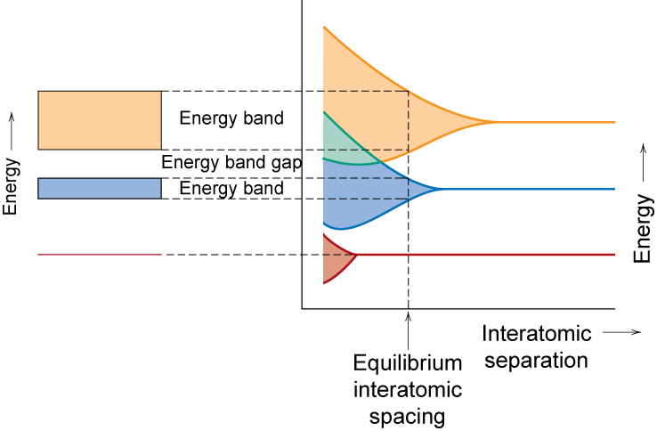
Band Structure
Valence band – filled – highest occupied energy levels: HOMO
Conduction band – empty – lowest unoccupied energy levels: LUMO
Conduction band
valence band
Notes:
contains valence electrons from the atoms

Slide 11
Energy levels of electrons
Highest energy level: E_{f} = Fermi energy
If E_{f} is located within a band, then metal
If E_{f} at the top of a band, with a small band gap (E_{g} < 2 eV), then semiconductor
If E_{f} at the top of a band, with a large band gap (E_{g} > 2 eV), then insulator

Slide 12
Conduction & Electron Transport
• Metals (Conductors):
-- Thermal energy puts
many electrons into
a higher energy state.
-
+
-
• Energy States:
-- for metals nearby
energy states
are accessible
by thermal
fluctuations.
Energy
Energy
empty
band
GAP
empty
partly
band
filled
filled
valence
valence
band
band
filled states
filled states
filled
filled
band
band

Slide 13
Energy States: Insulators & Semiconductors
• Insulators:
-- Higher energy states not
accessible due to gap (> 2 eV).
• Semiconductors:
-- Higher energy states separated
by smaller gap (< 2 eV).
Energy
Energy
empty
band
empty
?
band
GAP
GAP
filled
filled
valence
valence
band
band
filled states
filled states
filled
filled
band
band

Slide 14
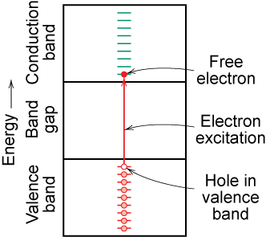
Charge Carriers
Two charge carrying mechanisms
Electron – negative charge
Hole – equal & opposite positive charge
Move at different speeds - drift velocity
Higher temp. promotes more electrons into the conduction band
∴ σ↑ as T↑
Electrons scattered by impurities, grain boundaries, etc.

Slide 15
Band structure and color
Metals: no band gap, don’t allow for visible light (photons) to propagate: appear shiny, silvery. Some (Au, Cu) do show certain colors due to absorptions
Semiconductors: Absorb photons with energies similar to those of band gaps; may be dark or colored. Visible photons go from ~1.8 eV (red) to ~3.1 eV (violet).
Insulators: have large band gaps, are often clear or white (scattering)

Slide 16
Metals: Resistivity vs T, Impurities
• Imperfections increase resistivity
-- grain boundaries
-- dislocations
-- impurity atoms
-- vacancies
These act to scatter
electrons so that they
take a less direct path.
6
ρ
Cu + 3.32 at%Ni
• Resistivity
increases with:
-- temperature
-- wt% impurity
-- %CW
5
Ohm-m)
Cu + 2.16 at%Ni
4
Resistivity,
deformed Cu + 1.12 at%Ni
3
-8
(10
2
Cu + 1.12 at%Ni
1
“Pure” Cu
ρ = ρ_{thermal} + ρ_{impurity} + ρ_{deformation}
0
-200
-100
0
T (°C)

Slide 17
Estimating Conductivity
• Question:
-- Estimate the electrical conductivity σ of a Cu-Ni alloy
that has a yield strength of 125 MPa.
180
ρ
50
160
Ohm-m)
140
40
125
30
120
Resistivity,
30
Yield strength (MPa)
-8
100
20
21 wt%Ni
(10
80
10
60
0
0
10
20
30
40
50
0
10
20
30
40
50
wt. %Ni, (Concentration C)
wt. %Ni, (Concentration C)
Adapted from Fig. 7.16(b), Callister 7e.
From step 1:
C_{Ni} = 21 wt%Ni

Slide 18
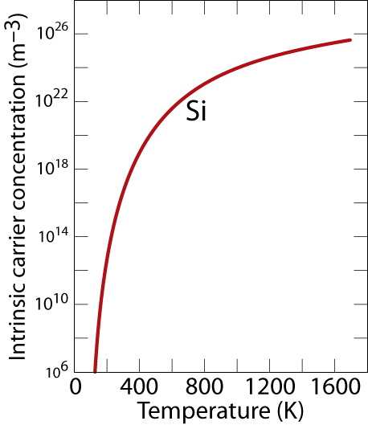
Intrinsic Semiconductors: Conductivity vs T
• Data for Pure Silicon:
-- σ increases with T
-- opposite to metals
material
Si
Ge
GaP
CdS
band gap (eV)
1.11
0.67
2.25
2.40
Adapted from Fig. 18.16, Callister & Rethwisch 9e.

Slide 19
Pure Semiconductors: Conductivity vs T
• Data for Pure Silicon:
-- σ increases with T
-- opposite to metals
Energy
electrical conductivity,
σ
empty
(Ohm-m)
-1
?
band
10
4
GAP
electrons
can cross
gap at
higher T
10
3
filled
2
valence
10
band
1
filled states
10
0
filled
10
pure
band
-1
(undoped)
10
material
Si
Ge
GaP
CdS
band gap (eV)
1.11
0.67
2.25
2.40
10
-2
50
10
0
1
000
T(K)

Slide 20
Conduction in Terms of Electron and Hole Migration
• Concept of electrons and holes:
valence
electron
hole
electron
hole
electron
Si atom
pair creation
pair migration
-
+
-
+
no applied
applied
applied
electric field
electric field
electric field
• Electrical Conductivity given by:
# holes/m
3
hole mobility
3
electron mobility
# electrons/m

Slide 21
Intrinsic vs Extrinsic Conduction
• Intrinsic:
# electrons = # holes (n = p)
--case for pure Si, Ge
• Extrinsic:
--n ≠ p
--occurs when impurities are added with a different
# valence electrons than the host (e.g., Si atoms)
• n-type Extrinsic: (n >> p)
• p-type Extrinsic: (p >> n)
Phosphorus atom
Boron atom
hole
4
+
4
+
4
+
4
+
conduction
4
+
4
+
4
+
4
+
electron
4
+
5+
4
+
4
+
4
+
3
+
4
+
4
+
valence
4
+
4
+
4
+
4
+
electron
4
+
4
+
4
+
4
+
no applied
Si atom
no applied
electric field
electric field

Slide 22
Extrinsic Semiconductors: Conductivity vs. Temperature
• Data for Doped Silicon:
-- σ increases doping
-- reason: imperfection sites
lower the activation energy to
produce mobile electrons.
doped
undoped
3
2
• Comparison: intrinsic vs
extrinsic conduction...
-- extrinsic doping level:
10²¹/m³ of a n-type donor
impurity (such as P).
-- for T < 100 K: "freeze-out“,
thermal energy insufficient to
excite electrons.
-- for 150 K < T < 450 K: "extrinsic"
-- for T >> 450 K: "intrinsic"
freeze-out
concentration (10²¹/m³)
extrinsic
intrinsic
Conduction electron
1
0
0
200
400
600
T
(K)

Slide 23
p-n Rectifying Junction: Diode
• Allows flow of electrons in one direction only (e.g., useful
to convert alternating current to direct current.
• Processing: diffuse P into one side of a B-doped crystal.
• Results:
+
p-type
-
n-type
+
+
-
--No applied potential:
no net current flow.
+
+
-
-
-
--Forward bias: carrier
flow through p-type and
n-type regions; holes and
electrons recombine at
p-n junction; current flows.
p-type
+
-
n-type
+
+
+
-
+
-
-
-
+
-
--Reverse bias: carrier
flow away from p-n junction;
carrier conc. greatly reduced
at junction; little current flow.
p-type
n-type
-
+
+
-
+
-
-
+
+
+
-
-

Slide 24
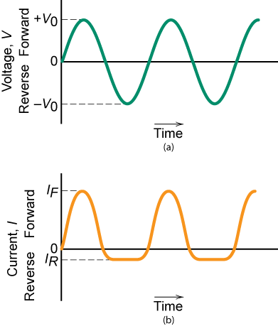
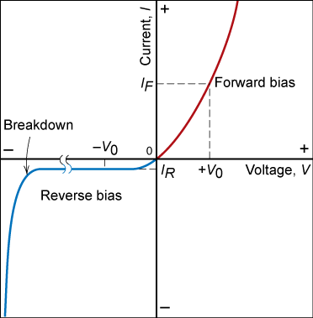
Properties of Rectifying Junction

Slide 25
Intrinsic Semiconductors
Pure material semiconductors: e.g., silicon & germanium
Group IVA materials
Compound semiconductors
III-V compounds
Ex: GaAs & InSb
II-VI compounds
Ex: CdS & ZnTe
The wider the electronegativity difference between the elements the wider the energy gap.

Slide 26
Doped Semiconductor: Conductivity vs. T
• Data for Doped Silicon:
-- σ increases doping
-- reason: imperfection sites
lower the activation energy to
produce mobile electrons.
• Comparison: intrinsic vs
extrinsic conduction...
-- extrinsic doping level:
10²¹/m³ of a n-type donor
impurity (such as P).
-- for T < 100 K: "freeze-out“,
thermal energy insufficient to
excite electrons.
-- for 150 K < T < 450 K: "extrinsic"
-- for T >> 450 K: "intrinsic"
10
4
σ
0.0052at%B
10
3
-1
10
2
doped
0.0013at%B
10
1
(Ohm-m)
electrical conductivity,
doped
10
0
pure
undoped
-1
(undoped)
3
10
2
extrinsic
10
-2
freeze-out
intrinsic
concentration (10²¹/m³)
50
10
0
1
000
conduction electron
T(K)
1
0
0
200
400
600
T
(K)

Slide 27
Number of Charge Carriers
Intrinsic Conductivity
σ = n|e|μ_{e} + p|e|μ_{h}
for intrinsic semiconductor n = p
∴ σ = n|e|(μ_{e} + μ_{h})
Ex: GaAs
For GaAs n = 4.8 x 10²⁴ m⁻³
For Si n = 1.3 x 10¹⁶ m⁻³

Slide 28
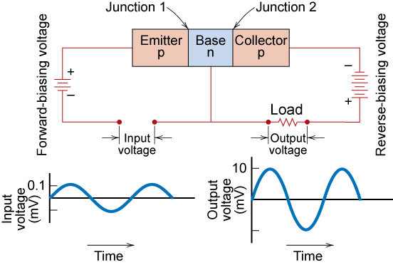
Junction Transistor
Fig. 18.24, Callister 7e.

Slide 29
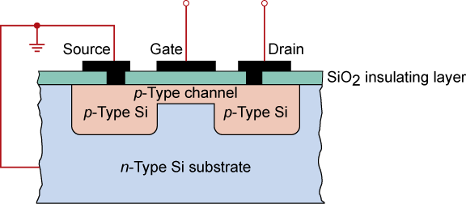
MOSFET Transistor Integrated Circuit Device
Fig. 18.26, Callister & Rethwisch 9e.
MOSFET (metal oxide semiconductor field effect transistor)
Integrated circuits - state of the art ca. 50 nm line width
~ 1,000,000,000 components on chip
chips formed one layer at a time

Slide 30
Integrated Circuit Devices: FET

Slide 31
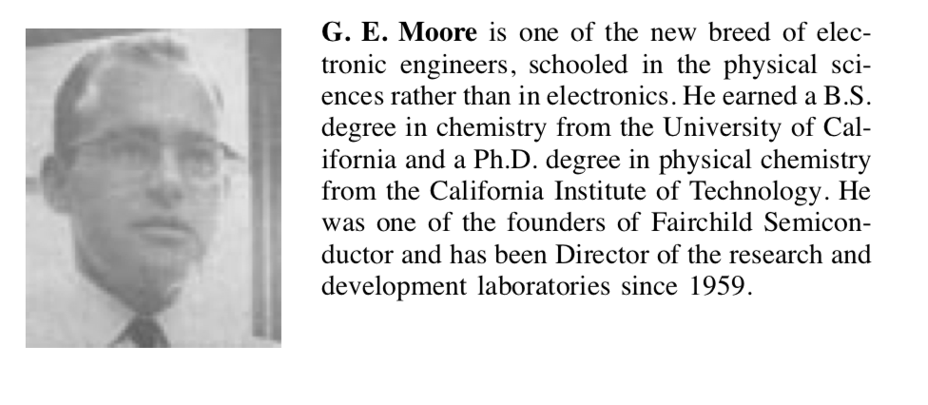
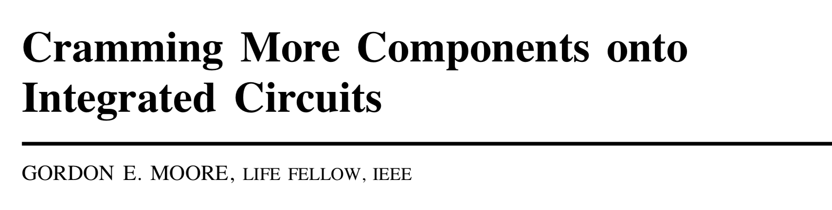
Solid-State Semiconductor Devices

Slide 32
Solid-State Semiconductor Devices

Slide 33
Solid-State Semiconductor Devices

Slide 34
Silicon single crystals

Slide 35
Czochralski process
Currently 300 mm (12 inch) wide x 775 μm thick
450 mm (18 inch) x 925 μm in development

Slide 36
Wafers: single crystal Si slices
Larger wafers (200 mm and up)
only have a single notch
2-inch (51 mm), 4-inch (100 mm), 6-inch (150 mm), and 8-inch (200 mm) wafers
a=0.5431 nm

Slide 37
Photolithography

Slide 38
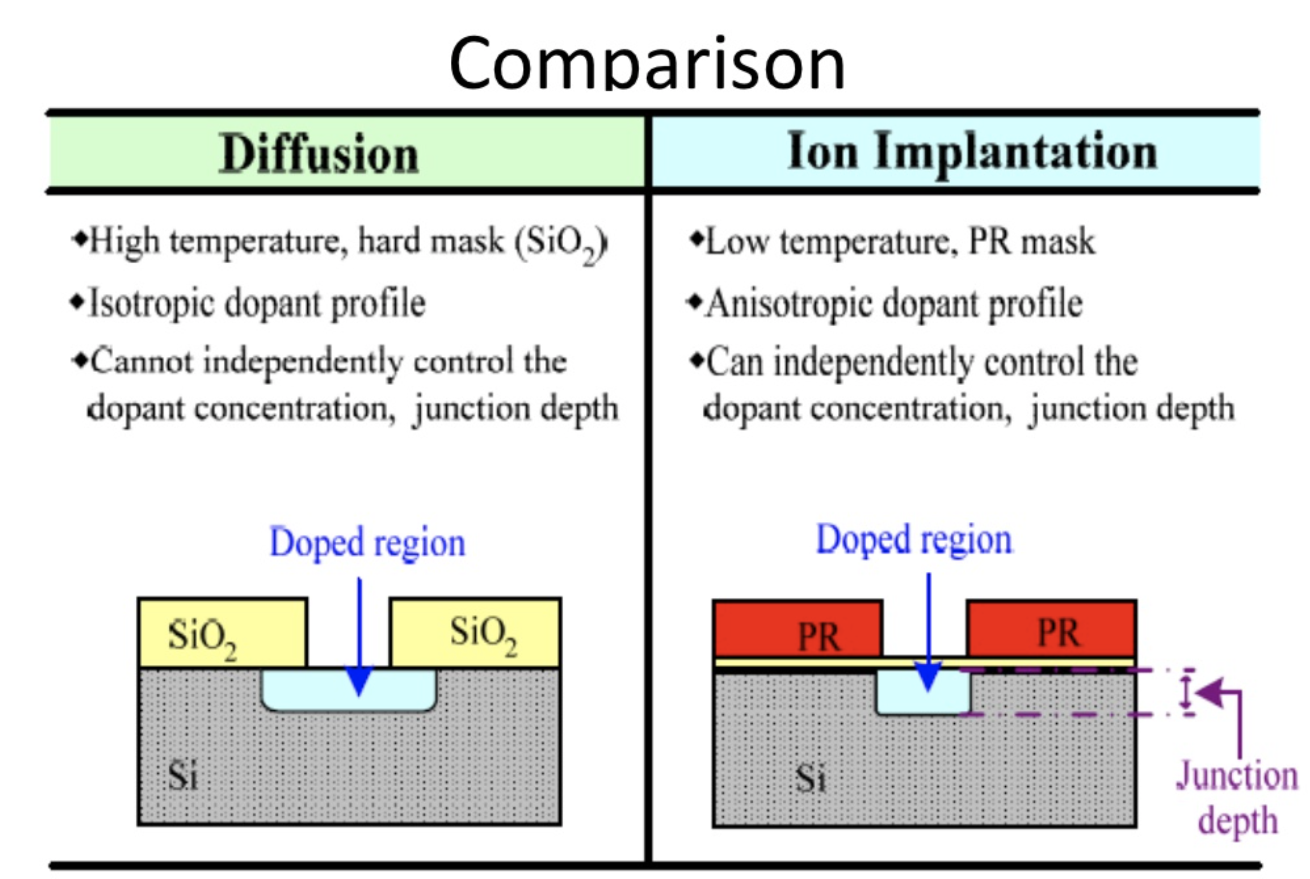
Doping

Slide 39
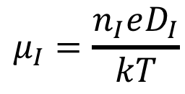
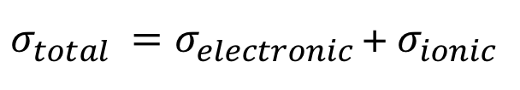
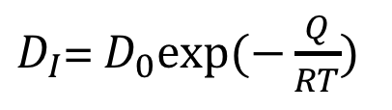
Ionic Conduction
Charged anions and cations can respond to electric fields and
contribute to current if they are sufficiently mobile
$σ_{total }=σ_{electronic }$+ $σ_{ionic }$
$$μ_{I}=\frac{n_{I}eD_{I}}{kT}$$
$D_{I}$= $D_{0}exp⁡(−\frac{Q}{RT})$
Important in certain ceramics, electrolytes, conjugated polymers

Slide 40
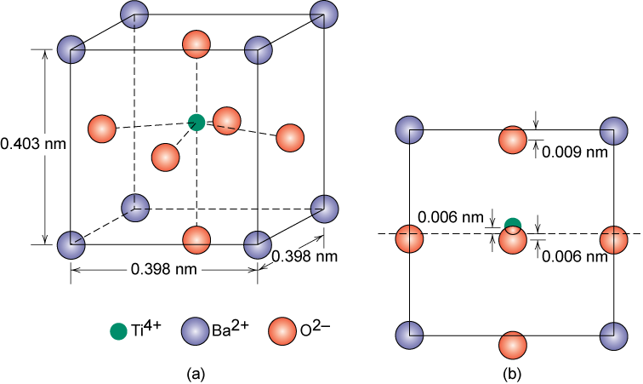
Ferroelectric Ceramics
Ferroelectric Ceramics are dipolar below Curie T_{C} = 120ºC
cooled below T_{c} in strong electric field - make material with strong dipole moment

Slide 41
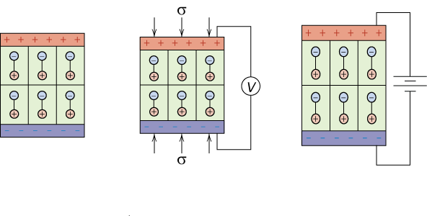
Piezoelectric Materials
Piezoelectricity – application of pressure produces current
at rest
compression induces voltage
applied voltage induces expansion

Slide 42
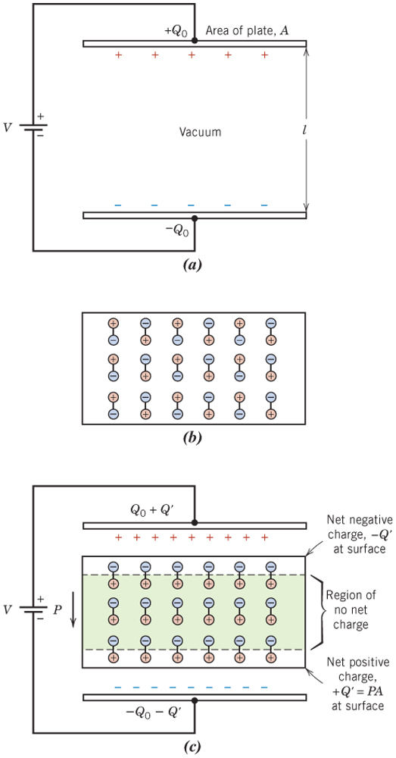
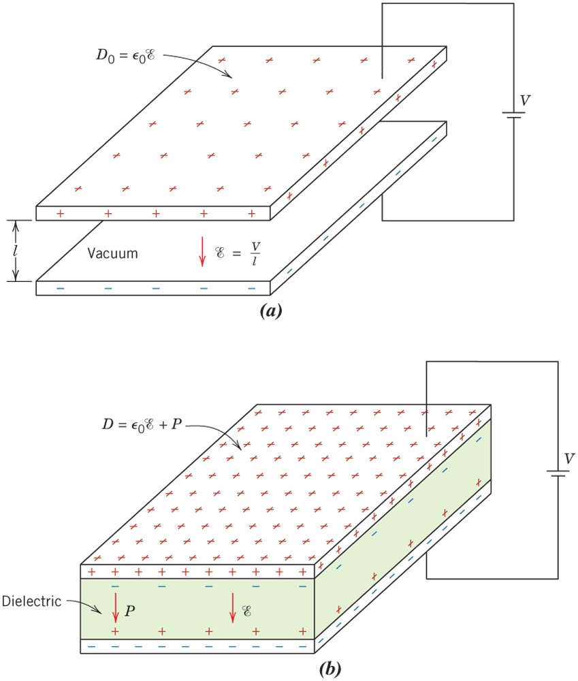
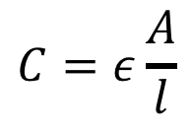
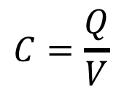
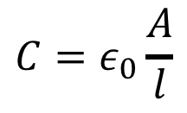
Capacitance
$$C=\frac{Q}{V}$$
$$C=ε_{0}\frac{A}{l}$$
$$C=ε\frac{A}{l}$$

Slide 43
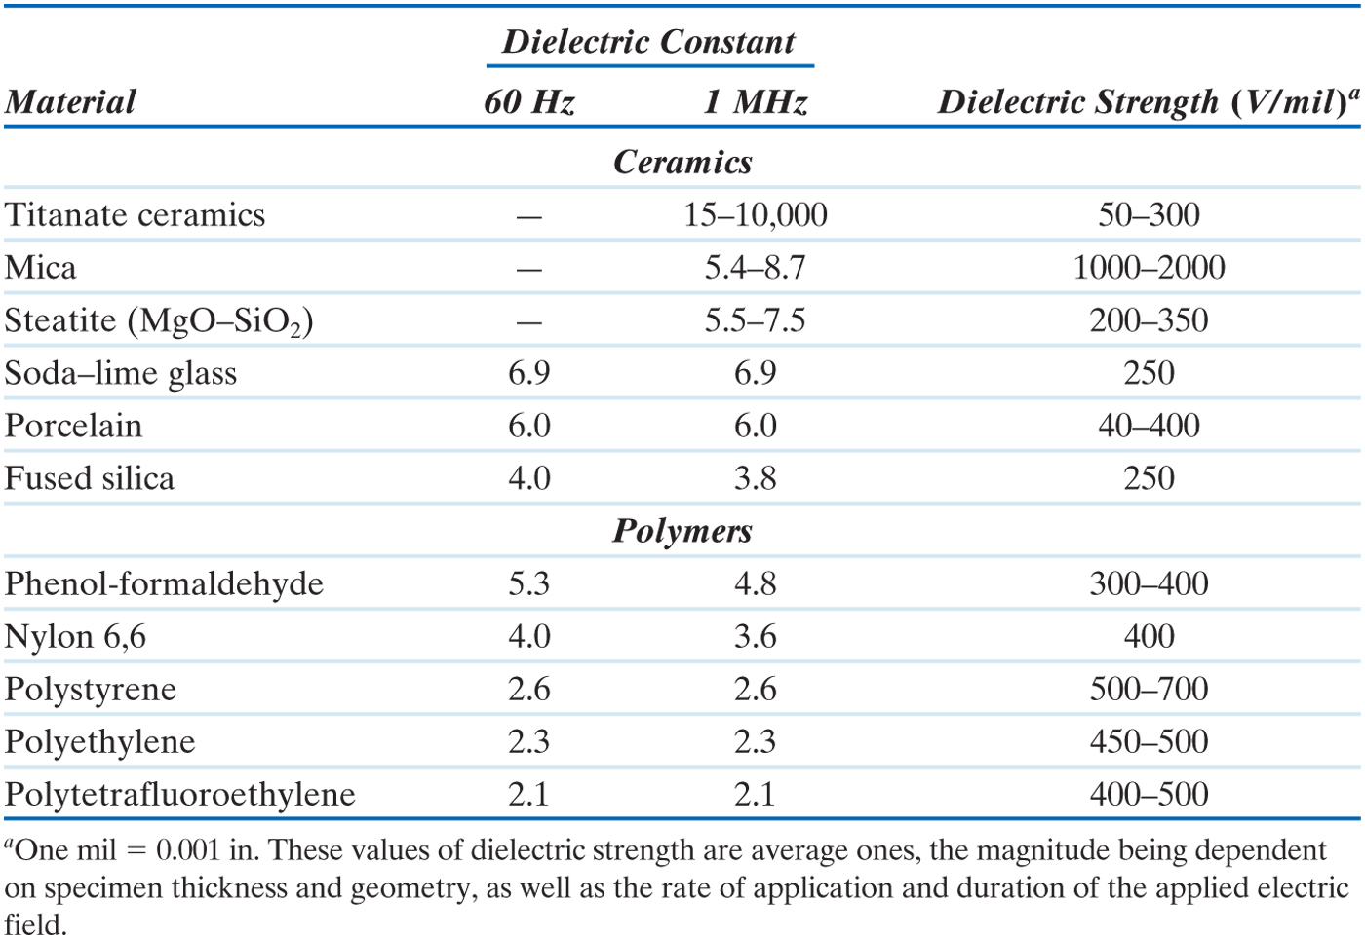
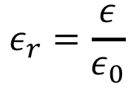
Dielectric properties
$$ε_{r}=\frac{ε}{ε_{0}}$$

Slide 44
Photovoltaics
light in
current out
Light Emitting Diodes: (LEDs)
Reverse this process: current in, light out

Slide 45
Tuning Band Gaps with Alloys
Lattice constant (Angstroms)

Slide 46
Tuning Band Gaps with Alloys

Slide 47
Tune crystal with composition
Atomic fraction

Slide 48
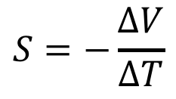
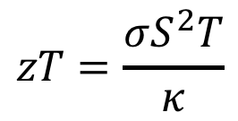
Thermoelectrics
$$S=−\frac{∆V}{∆T}$$
$$zT=\frac{σS^{2}T}{κ}$$

Slide 49
Thermoelectric Applications
Heat in
Electricity out
Electricity in
Heat out

Slide 50
Summary
• Electrical conductivity and resistivity are:
-- material parameters.
-- geometry independent.
• Electrical resistance is:
-- a geometry and material dependent parameter.
• Conductors, semiconductors, and insulators...
-- differ in accessibility of energy states for
conductance electrons.
• For metals, conductivity is increased by
-- reducing deformation
-- reducing imperfections
-- decreasing temperature.
• For pure semiconductors, conductivity is increased by
-- increasing temperature
-- doping (e.g., adding B to Si (p-type) or P to Si (n-type).

Slide 51
HW #12: Last One
In the Chat section of the course web site on
Canvas, post a question about any aspect of
the course. On the last day of class next Tuesday,
the instructor will do his best to answer as many of
these questions as possible. We will give a full homework assignment credit to all students who post a question.

Slide 52
Example Grading scale from 2010
HW: 150
M1: 250
M2: 250
Final: 350
Tot: 1000
A+ 830
A 791
A- 757
B+ 701
B 636
B- 603
C+ 564
C 534
C- 511
D+ 468
D 409
E <400
A+
A
A-
B+
B
B-
C+
C
B-
C
C-
D+
D
E
Specific numbers will be different this year
but overall distribution likely similar

